Slide 1

Cambridge Medical Associates
Patient Safety Improvement Project- Increasing Diabetic Eye Exams
Community Learning Session #4
March 4th, 2016

Slide 2
Aim Statement
Improve Diabetic Eye Exam rate from baseline of 50% to 75% by 6/30/2016.
Why this is important for Patient Safety?
  Prevents Diabetic Retinopathy
  Improved efficiency by becoming part of the morning huddle for providers and developing communication with the patients
  Orders are created in our EMR and tracked to make sure patients are seen by Ophthalmologist and results are communicated with the patient.

Slide 3
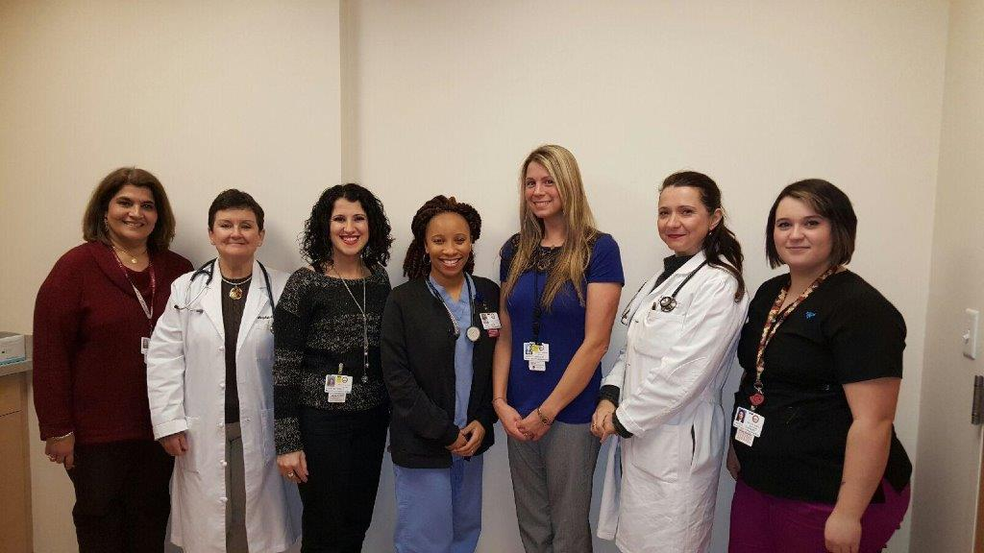
Team Members
Lucy Moushigian:Revenue Cycle Specialist/Medical Secretary
Dr. Marybeth Ferrante: Physician
Christina Rebelo: Referral Coordinator/Medical Secretary
Ricara Moore: Medical Assistant,
Lindsey Moscato: Practice Manager
Alexandra Chabrerie, MD: Physician Champion
Andrea Carreiro: Medical Assistant

Slide 4
What we are Measuring?
We have our baseline list of patients who are diabetics and as of January 1, 2016 we can see from this list who has had eye exams and who has not.
Measure patients who do have eye exams via reports back from Ophthalmologists, starting on January 1 through June 30, 2016.
What we learned
  Patients had gone for exams but the reports were not received by the PCP.
Notes:
We have learned that patients have gone for exams but the reports have not been sent back to the PCP. Also that reports were not scanned into the proper place in eCW (which does not show up on the reports) we have also learned that

Slide 5
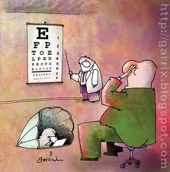
Diabetic Eye Exam

Slide 6
What we are Testing?
First test idea
  Letter to patients
We learned from the above test
  Keep the letter short and to the point vs long and detailed
Patient engagement
  Patient letter
  Best method of communication
Notes:
I first ran a report off all the DM pt’s for CMA. I broke down between each provider, I then went through to see when the last eye exam was, looked for a report/eye dr name. If this was missing I contacted through phone/letter to the patient. If they did not have a provider I referred to OCB (who we have teamed up with for a quality improvement project) The biggest thing I learned was that more than half the patient actually have gone for exams the office just did not get results.
I involved one patient and asked what he thought about for a letter/outreach. Advise I got was keep the letter short and to the point, pt’s do not want to feel harassed but more “helped”

